Slide 1
Iball app
Exercise tracking app targeting players ages 10 - 18

Slide 2
Why build this app
Many athletes do better academically Playing a sport requires a lot of time and energy. Some people may think this would distract student-athletes from schoolwork. However, the opposite is true. Sports require memorization, repetition and learning.
Sports teach teamwork and problem-solving skills Fighting for a common goal with a group and coaches teaches you how to build teamwork and effectively communicate to solve problems.
Sports boost self-esteem Watching your hard work pay off and achieving your goals develops self-confidence. Achieving a sport or fitness goal encourages you to achieve other goals you set.

Slide 3
Problems to solve
exercise progress can be tracked
user can search for exercise example videos
users can collaborate on exercises
Awards for challenges

Slide 4
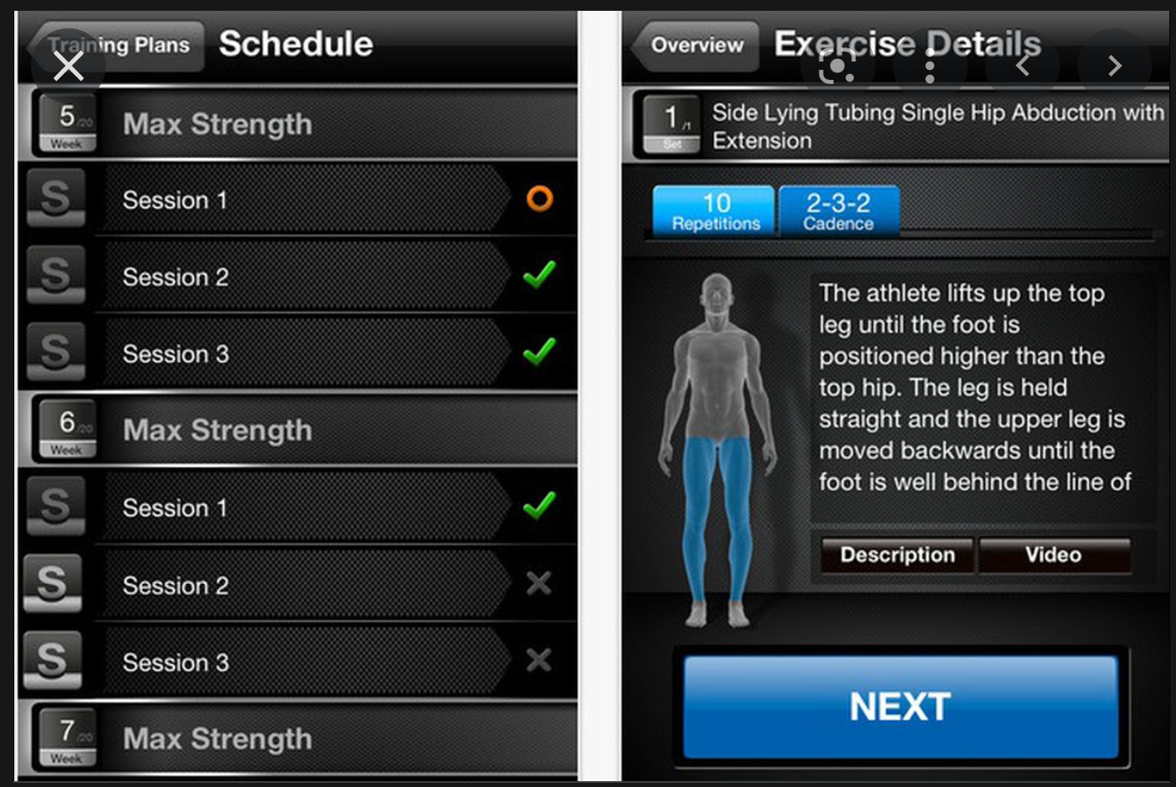
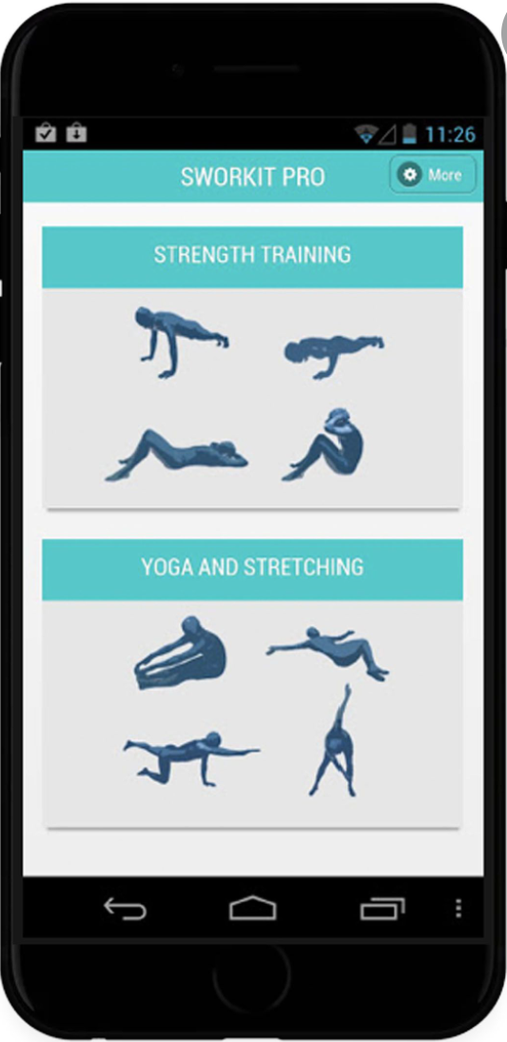
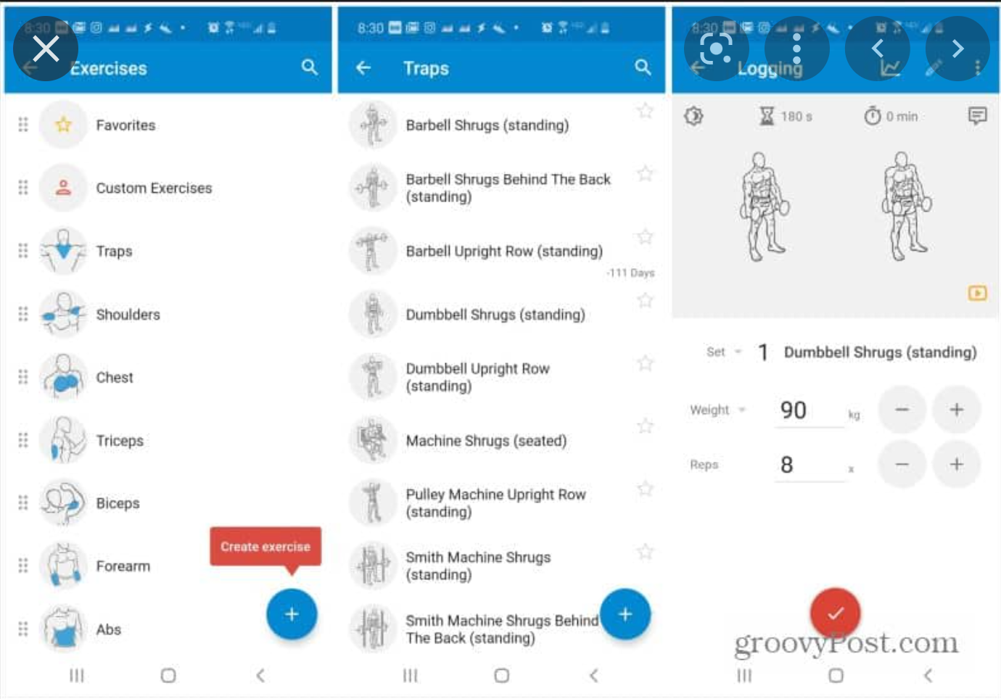
Research

Slide 5
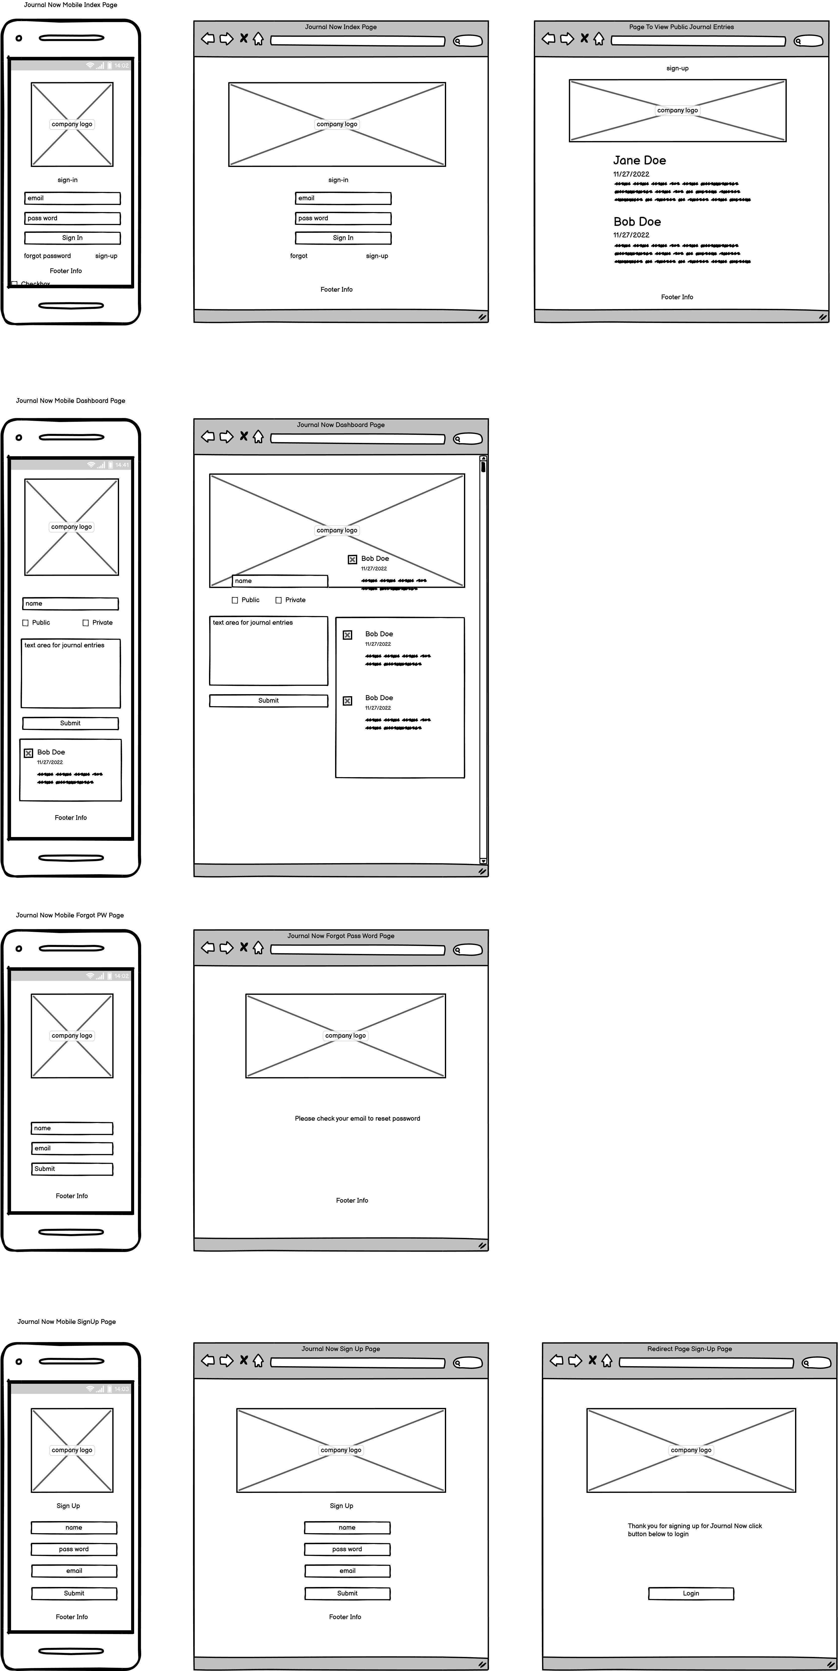
Wireframe
Balsamiq Prototype

Slide 6

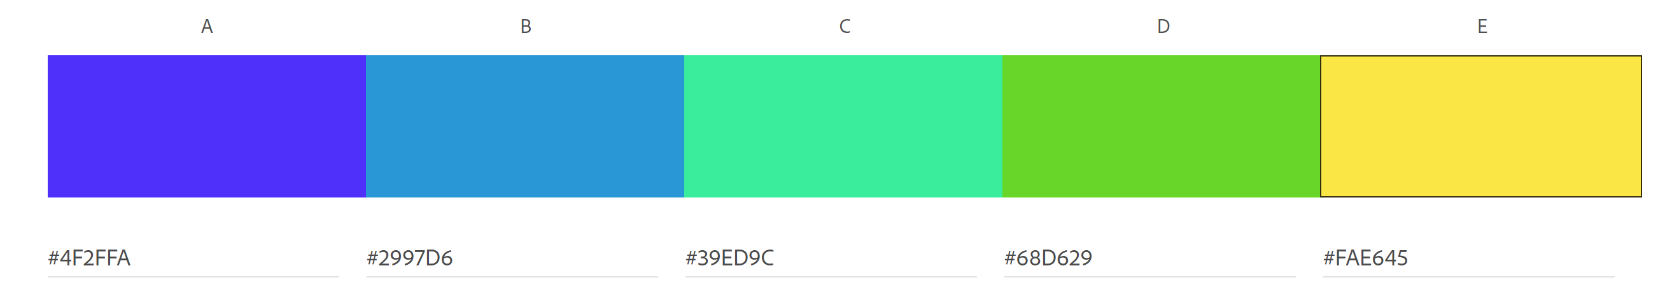
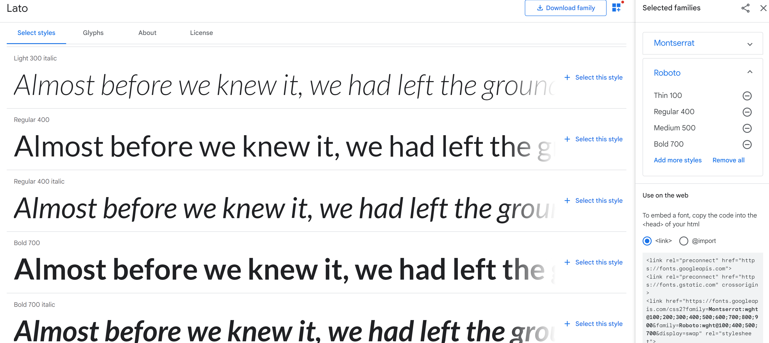
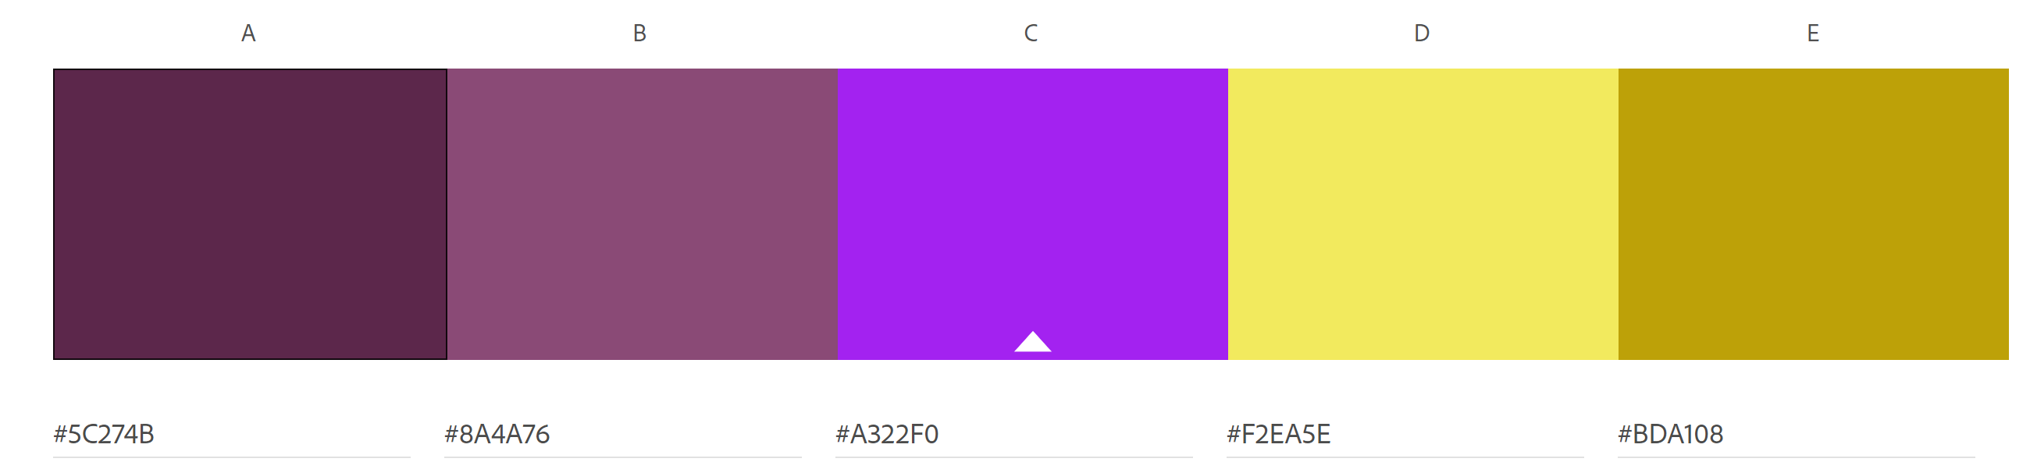
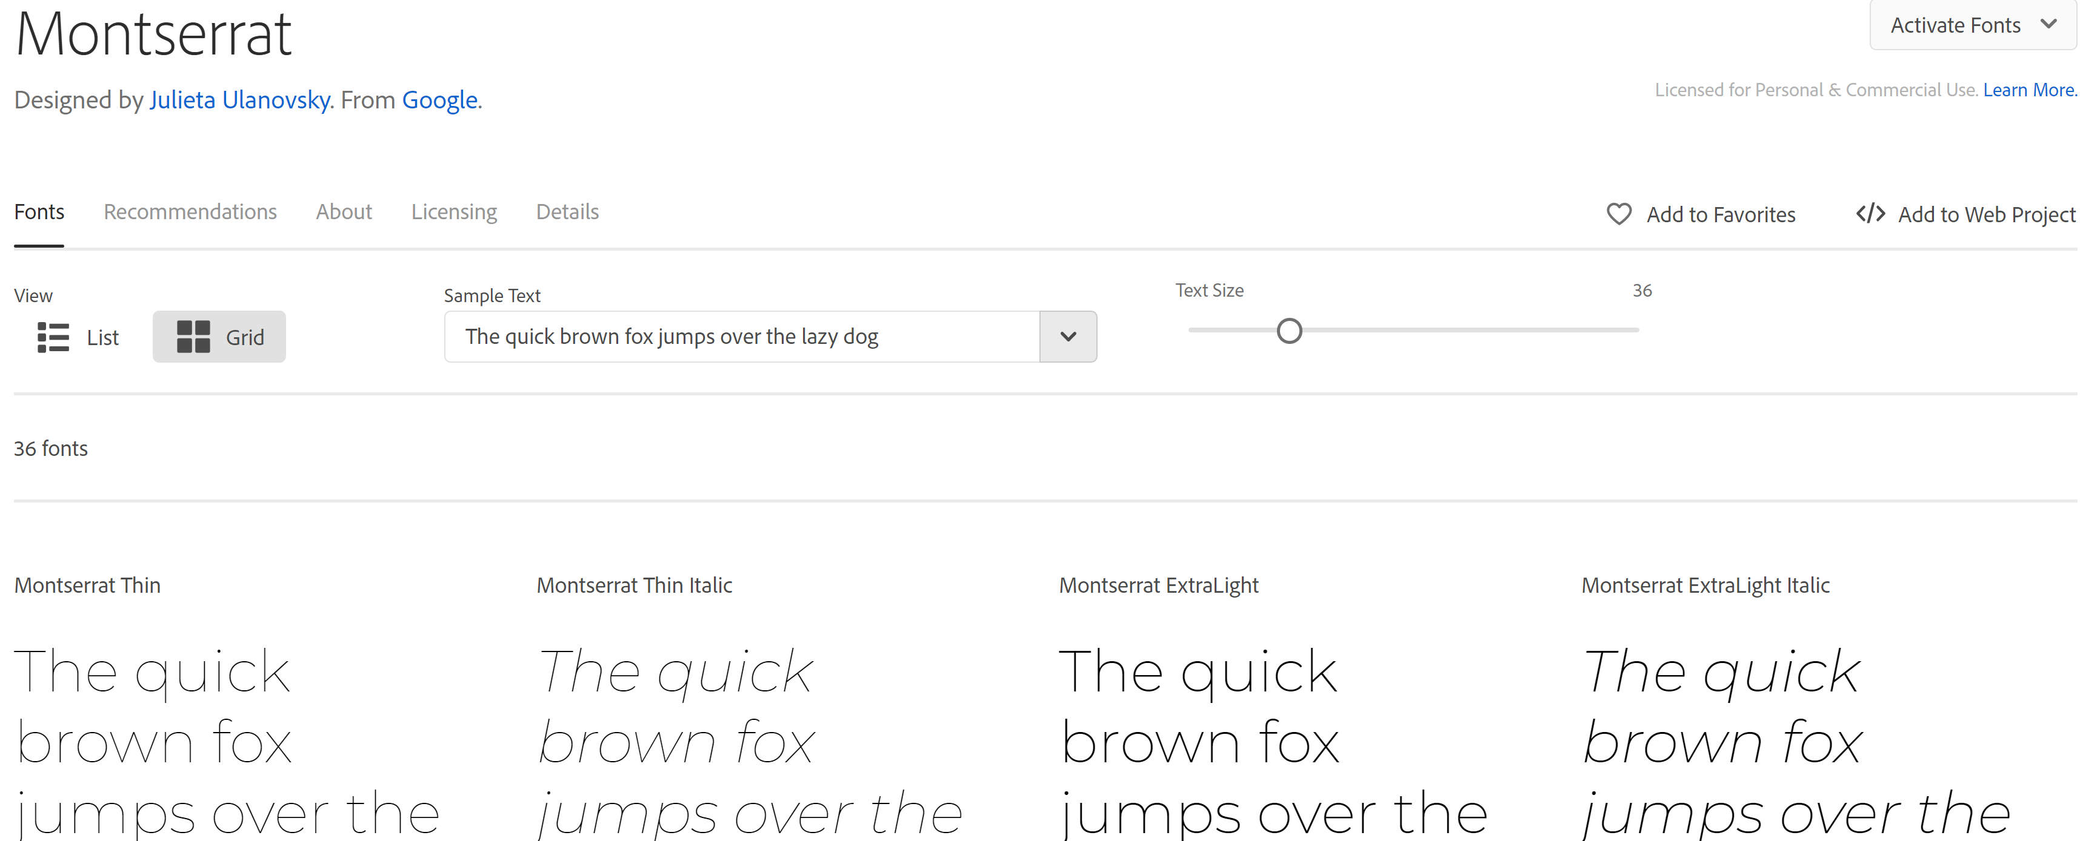
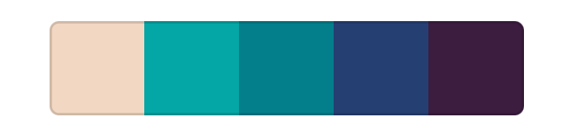
assets
Color Palette
Paletton
Adobe Color CC
ColoRotate
Mudcube Color Sphere
Fonts
fontpair.co
Adobe Fonts
Google Fonts

Slide 7
Create git repository
Git is a DevOps tool used for source code management. It is an open-source version control system used to handle small to very large projects efficiently. Git is used to tracking changes in the source code, enabling multiple developers to work together on non-linear development.

Slide 8
html
PhpStorm is an IDE (Integrated Development Environment) for PHP and web developers, which is engineered by JetBrains

Slide 9
tailwind CSS
A utility-first CSS framework for rapidly building custom designs. Tailwind CSS is a highly customizable, low-level CSS framework that gives you all of the building blocks you need to build designs without opinionated styles you have to override.

Slide 10
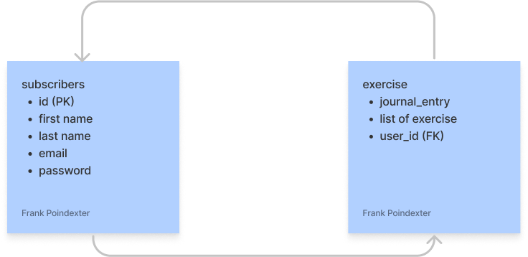
database
1.Supabase to create database
2.Copy the relevant database info (url, key, ect)
3.Copy database info (port, data base name, host)
4.Create data base tables
5. Test database in browser

Slide 11
Js Code/React
Logic
Set variables for elements
functions for logic
Use Fetch(), .Then(), .Catch() server data api
Add event listeners
Employed filter(),map() to manipulate the js object

Slide 12
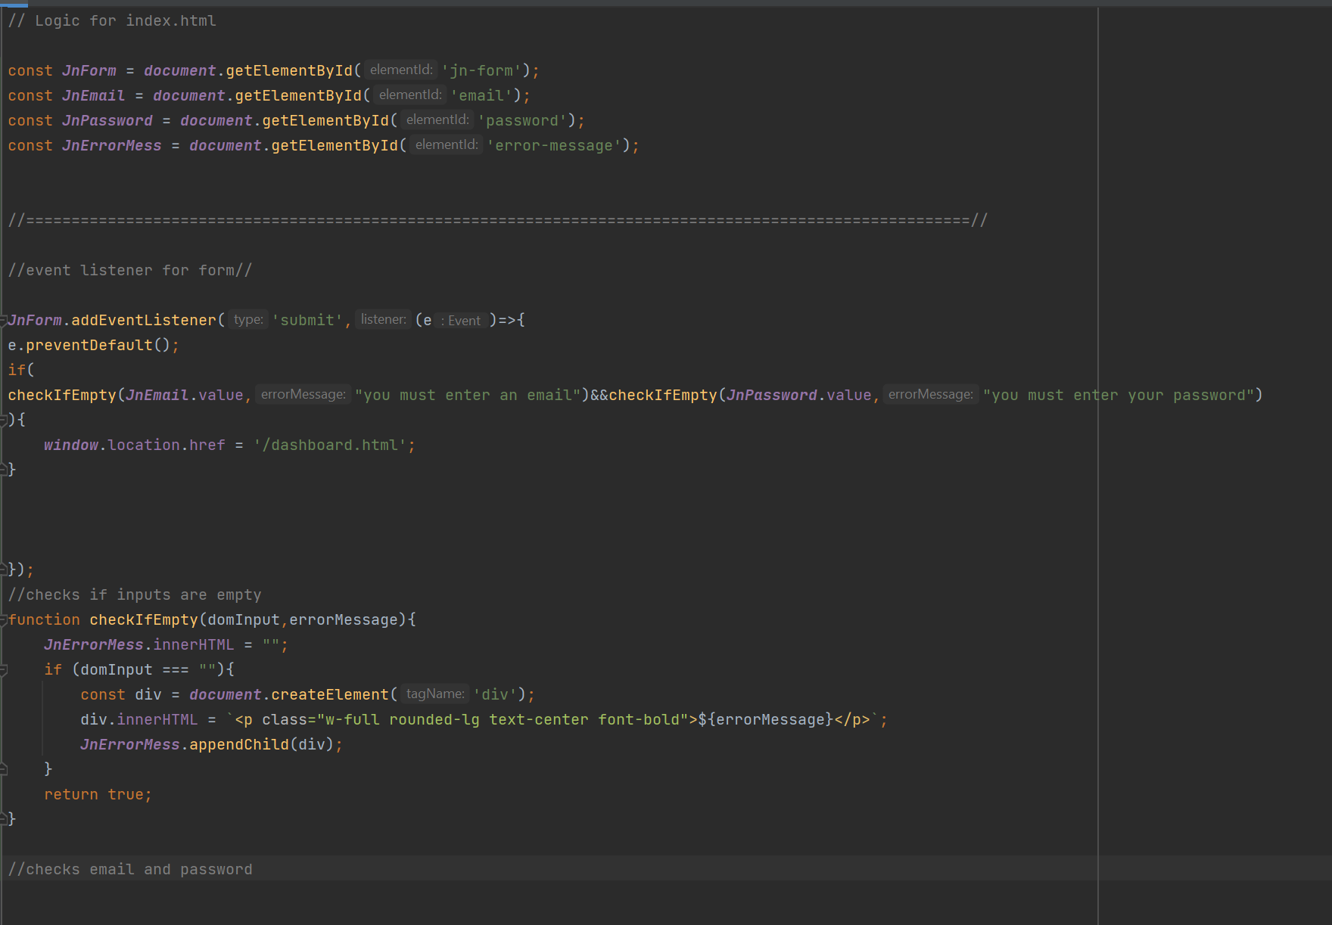
react
JAVASCRIPT
Created js. folder
Created first js. File app.js for index page
Created second js. File dashboard.js
Validated inputs for app.js file
Created event listener for the index page sign in form directing user to dashboard page
Validated inputs for dashboard.js
Created event listener for the dashboard form which enabled user to add their story to company intranet

